Slide 1
HSC 509: Perspectives on Human Behaviour
Department of Humanities and Social Sciences
Indian Institute of Technology(ISM) Dhanbad
Monsoon Semester 2022-23

Slide 2
Two Narratives in Social Sciences
Ultimate Explanation
Essential Nature of Things
Evidence

Slide 3
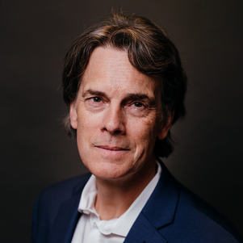
Two Narratives in Social Sciences
Big Bang Narrative
Creation Narrative
[Note: Based on ‘the Philosophy of Education’ lecture series by Prof. Stephen Hicks]

Slide 4
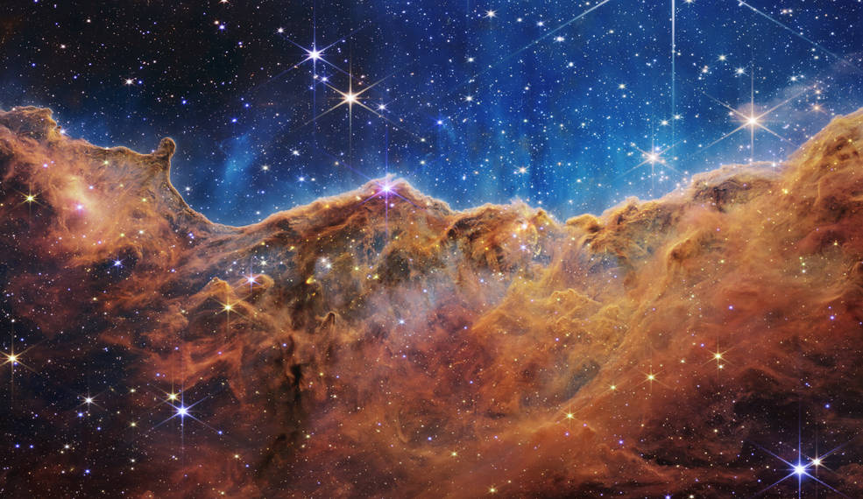
Big Bang Narrative

Slide 5
Explosion
14 Billion years ago there was...
A Tiny bubble
Explosion
Time, Space and Matter – all began from this point...
Notes:
Food for Thought: Where did it expand, if there was no space?

Slide 6
Expansion and Cooling
The universe expanded rapidly and lost energy...
Energy was converted to matter
Further cooling let to formation of chemicals
Notes:
Food for Thought: Where did it expand, if there was no space?

Slide 7
Some 10 billion years ago...
Galaxies formed
Earth is formed (~9.5 billion years ago)
Early life (~ 4 billion years ago)
Homo Sapiens (200,000 years ago)

Slide 8
Civilizations
Use of metals and agriculture (~ 15,000 years ago)
Technology
Arts

Slide 9
Research Methodology
Body of Knowledge
Physics, Chemistry, Geology, Biology
Anthropology
Social Sciences
Humanities
Method
Observation – Analysis – Logic – Scientific Method

Slide 10
Worldview
Most Fundamental Aspect: MATTER / PHYSICAL
Psychological Nature: Derived from the Physical
Metaphysical: No metaphysics
Purpose of Life: Physical / tangible things
Innate Nature: Progressive and Dominant
Notes:
Metaphysics: no soul, no afterlife
Meaning of life: tangible pleasure
Natural tendency: progressiveness/dominance

